Slide 1
Brightcove Video Cloud Essentials
Bob Bailey
bbailey@brightcove.com

Slide 2
Agenda
The Video Cloud Platform
1
Quick Video Publish
2
Setting Video Properties
3
Creating and Customizing Players
4
Setting Player Properties
5
Creating Playlists and Publishing
6
Analytics
7
Account Management
8

Slide 3
The Video Cloud Platform

Slide 4
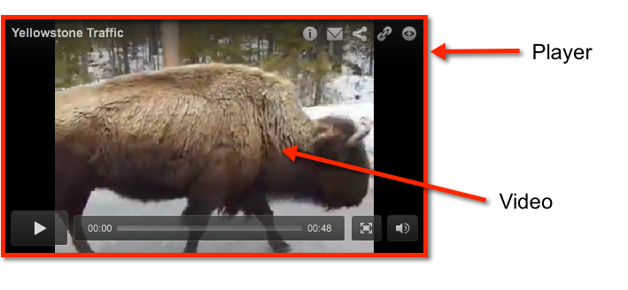
Terminology
Video
Player
Notes:
4

Slide 5
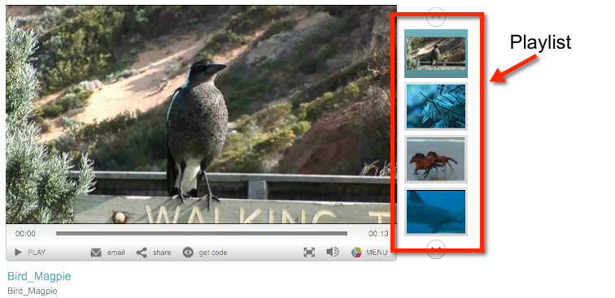
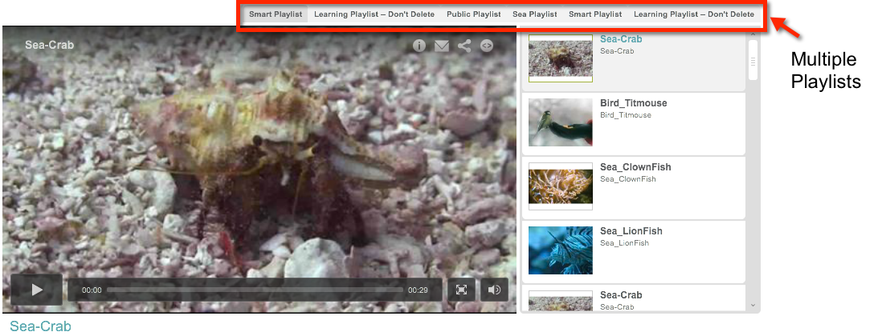
Terminology
Playlist
A grouping of videos
Players can support single or multiple playlists
Notes:
5

Slide 6
Smart players
Allow you to use a single Video Cloud player that can deliver video in Flash or HTML5
Video Cloud detects the device and delivers the appropriate type of player
You only create one player in Video Cloud Studio, no need to manage different players for different environments
For more information
Delivering Video with HTML5 and Smart Players in the docs
Notes:
6

Slide 7
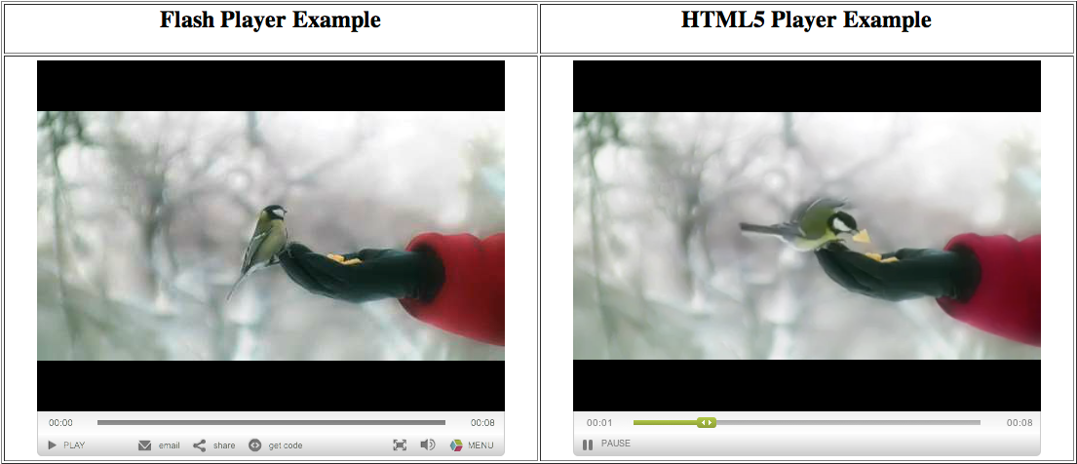
Flash Player vs. html5 player
Notes:
7

Slide 8
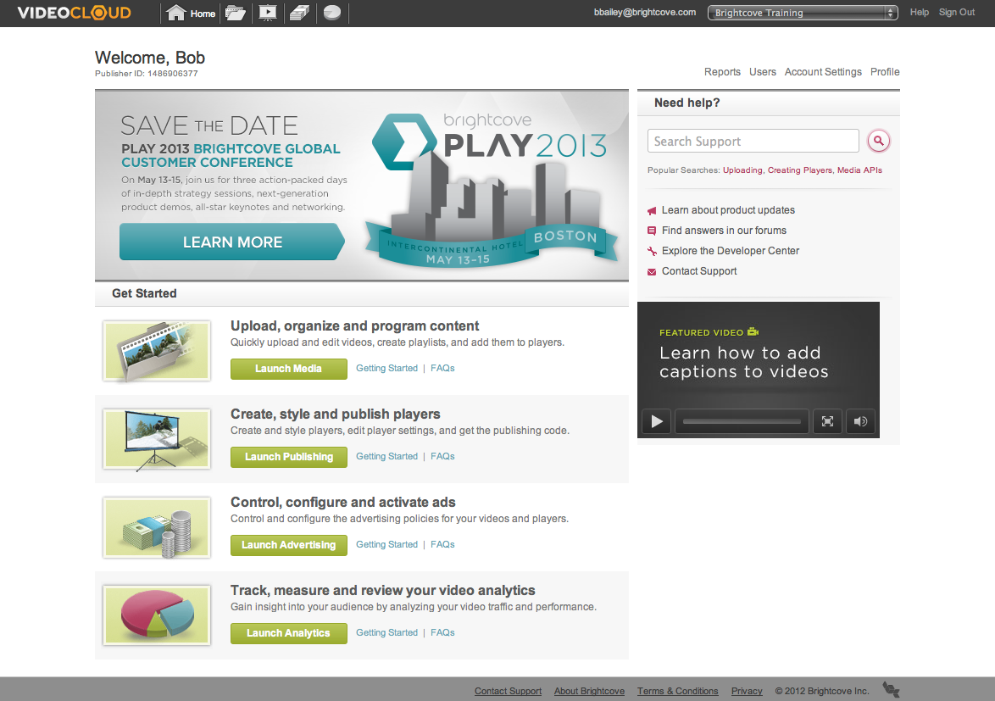
The Video Cloud Platform Architecture
Publishing code
(Publisher, Player
Video IDs, Player
Dimensions)
Transfer videos
Your Web Server
Content Delivery Network
(CDN)
Video Cloud Servers
Requested page
with references
to player and
videos
Transcode and
store videos with
metadata, playlists,
player settings
Upload video,
add settings
Video Cloud Studio
Viewer
Your System

Slide 9
The Video Cloud Platform Architecture
Video Cloud Studio

Slide 10
The Video Cloud Platform Architecture
Upload video,
add settings
Video Cloud Studio
Your System

Slide 11
The Video Cloud Platform Architecture
Video Cloud Servers
Transcode and
store videos with
metadata, playlists,
player settings
Upload video,
add settings
Video Cloud Studio
Your System

Slide 12
The Video Cloud Platform Architecture
Transfer videos
Content Delivery Network
(CDN)
Video Cloud Servers
Transcode and
store videos with
metadata, playlists,
player settings
Upload video,
add settings
Video Cloud Studio
Your System

Slide 13
The Video Cloud Platform Architecture
Publishing code
(Publisher, Player
Video IDs, Player
Dimensions)
Transfer videos
Your Web Server
Content Delivery Network
(CDN)
Video Cloud Servers
Transcode and
store videos with
metadata, playlists,
player settings
Upload video,
add settings
Video Cloud Studio
Your System

Slide 14
The Video Cloud Platform Architecture
Publishing code
(Publisher, Player
Video IDs, Player
Dimensions)
Transfer videos
Your Web Server
Content Delivery Network
(CDN)
Video Cloud Servers
Requested page
with references
to player and
videos
Transcode and
store videos with
metadata, playlists,
player settings
Upload video,
add settings
Video Cloud Studio
Viewer
Your System

Slide 15
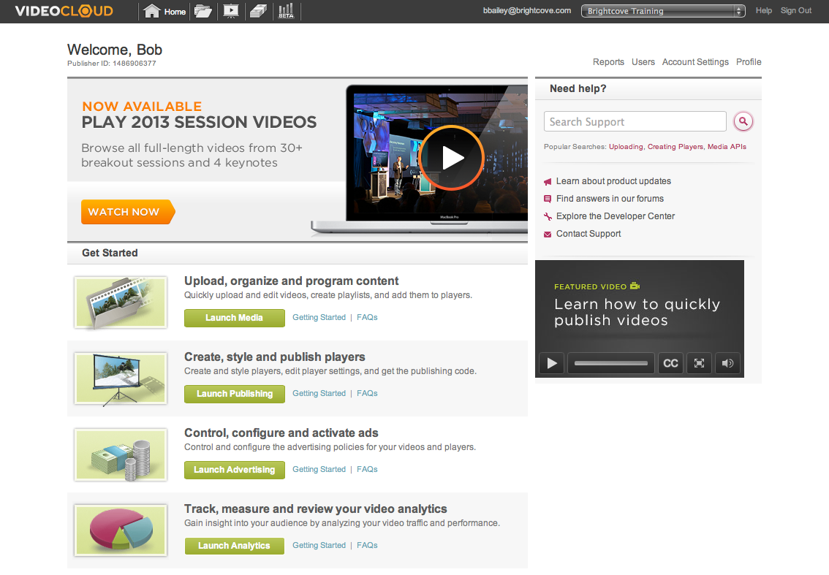
Navigating Video Cloud Studio
User login and active account
Help center
Home, Media, Publishing, Advertising and Analytics modules
Account menu
Learning and Help Resources
Media module
Publishing module
Advertising module
Analytics module

Slide 16
Preparing and Uploading Content

Slide 17
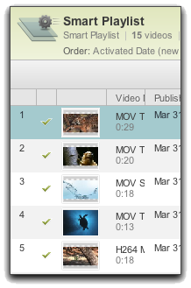

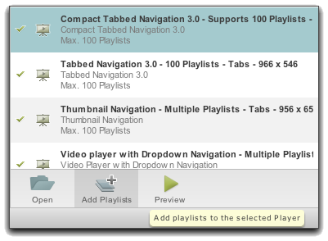
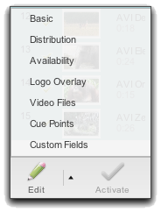

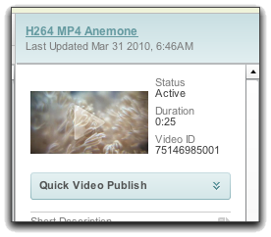

Media Management Workflow
3a
1
Media Module
Create Playlists
(optional)
4
Assign to Player (created in the Publishing Module)
Upload Media
2
Edit Video Properties
(optional)
5
Get Publishing Code (Publishing Module)
3b
Quick Publish
(single video only)
Notes:
17
Management or Preparation/

Slide 18
Video Formats
Not Transcoded
Recommended for best quality
Extension | File Format
.MP4, .F4V | H.264 (MPEG-4 Part 10), MPEG-4 Part 14
.3g2 | 3GP for CDSM phones
.3gp | 3GP for GSM phones
.asf | Streaming format for Windows Media Player
.avi | Windows video format
.dv | Digital video
.mov | QuickTime Multimedia format
.mp4 | MPEG-4 Part 14
.mpeg | MPEG-1
.mpg | MPEG-1
.qt | QuickTime Video
.wmv | Windows Media Video
Recommended for best quality and fastest encoding
H 264
FLV
NOT recommended – will not play in HTML5 players
Transcoded
Notes:
18
Any video files that aren't FLV or H.264 will be transcoded into FLV or H.264.
H.264 high definition video – this will give you the best video renditions

Slide 19
Upload Options
Media Module
Batch Provisioning
Media API
GUI-Based
BC Encoding
2 GB Limit/Video
Images created for transcoded files
Single or multiple videos
FTP & XML
BC Encoding for files < 2 GB
If you use DIY Encoding, NO GB Limit
For large volume of videos
CMS integration
Any supported video format
BC Encoding
Not good for volume uploading – single-threaded uploads
for Pro and Enterprise Editions
19
Notes:
19
19
Let them know we will not be talking about the Media API in this course.

Slide 20
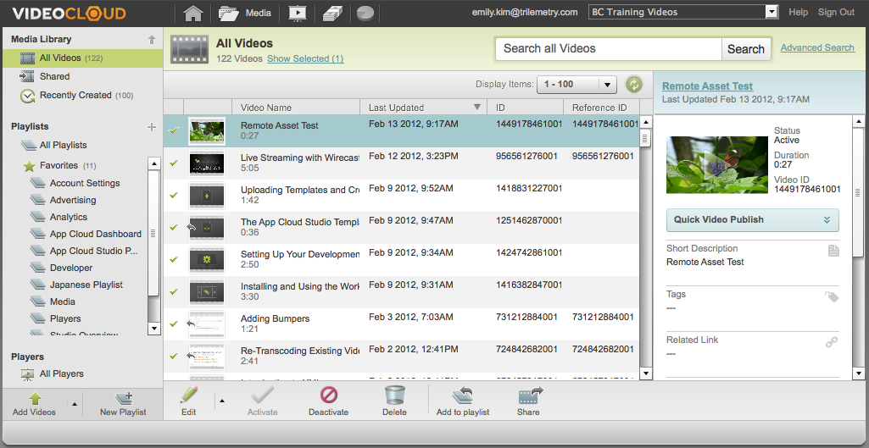
Media Module Upload
Notes:
20
The thought here is NOT to show this as a demo

Slide 21
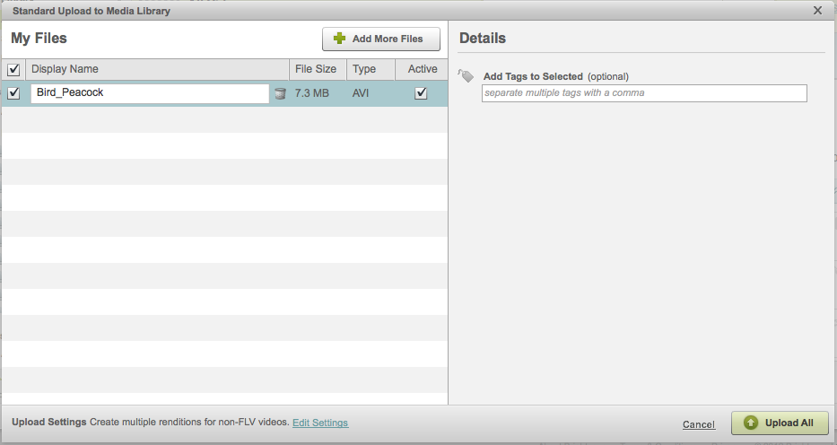
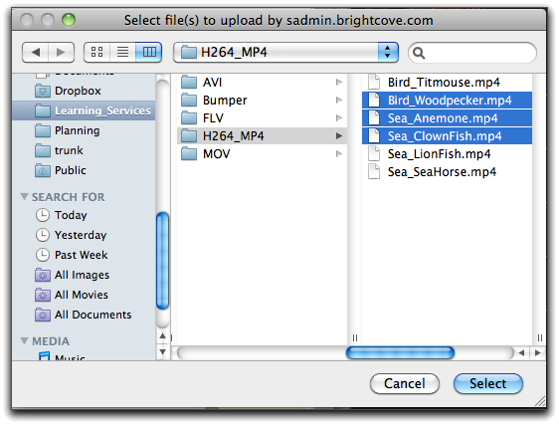

Media Module Upload
Display/Title Name
Tags
Status
Multiple Renditions

Slide 22
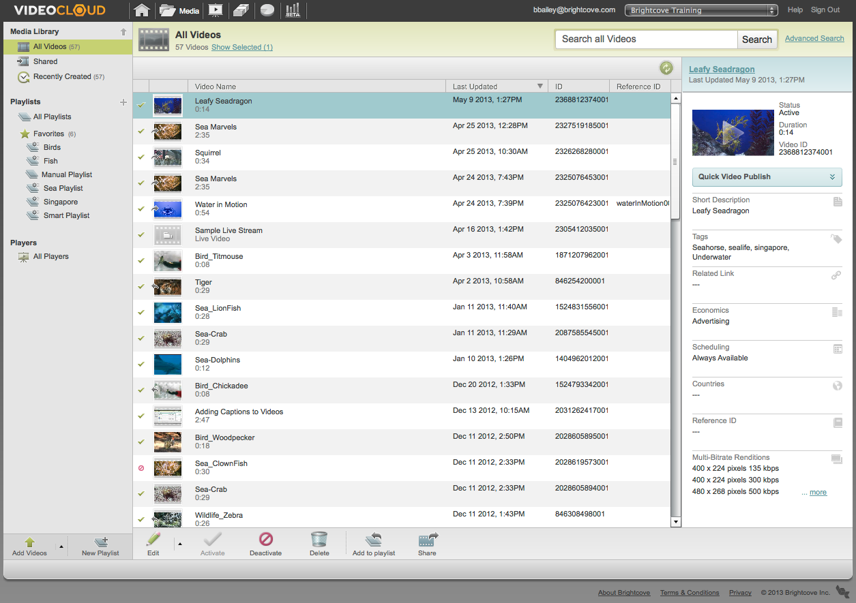
Media Module Media Library
Notes:
22

Slide 23
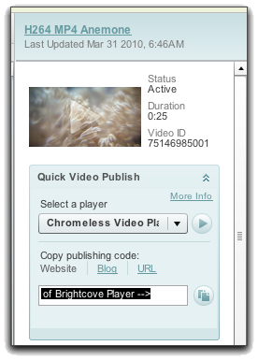
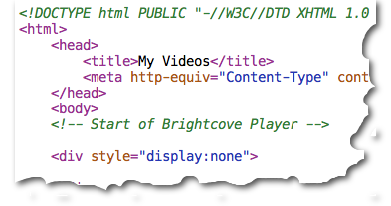
Quick Video Publishing
Great way to quickly publish a single video
Steps
Upload a video
Select a player
Copy the publishing code
Paste the code in a web page
You are done!!
Notes:
23
The components involved in the Brightcove Platform

Slide 24
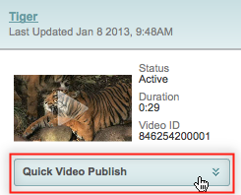
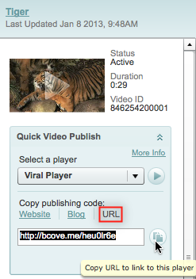
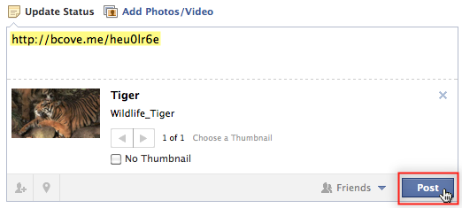
Quick Video Publishing
Can use Quick Video Publish to quickly get your video out to Facebook
Copy URL and paste to your Facebook wall
Notes:
24
The components involved in the Brightcove Platform

Slide 25
Setting Video Properties

Slide 26
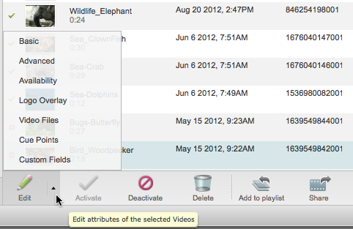
Video Properties
Basic
Advanced
Availability
Logo Overlay
Video Files
Cue Points
Custom Fields

Slide 27
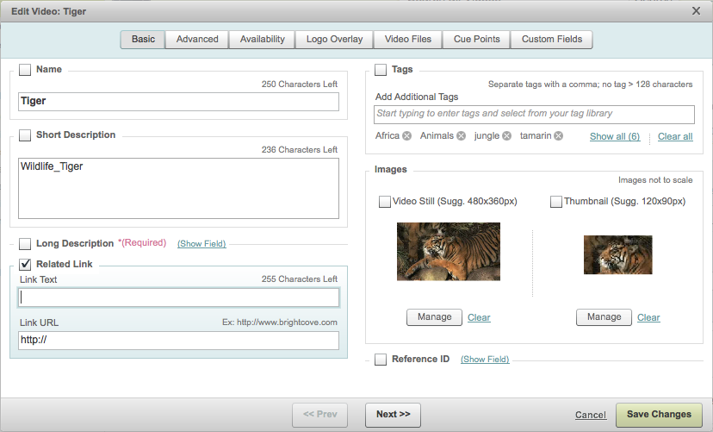

Video Properties: Basic Settings
Notes:
27

Slide 28
Video Properties: Basic Settings
Notes:
28
Images are created upon upload for FLV files, you can use this if you want to change the one that has been uploaded or you need to create one for a non FLV file
The thumbnail image is displayed in the playlist tabs of a Tabbed or Compact Tabbed player, or in the video list of a Widescreen with Horizontal List player. It is also displayed in the Media module.
The video still is displayed in the playback area of a video player before or after video playback.

Slide 29
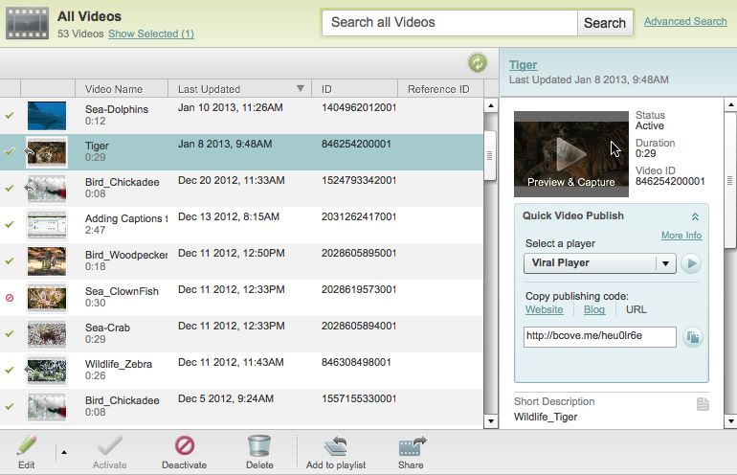
Video Properties: Image Capture
Notes:
29

Slide 30
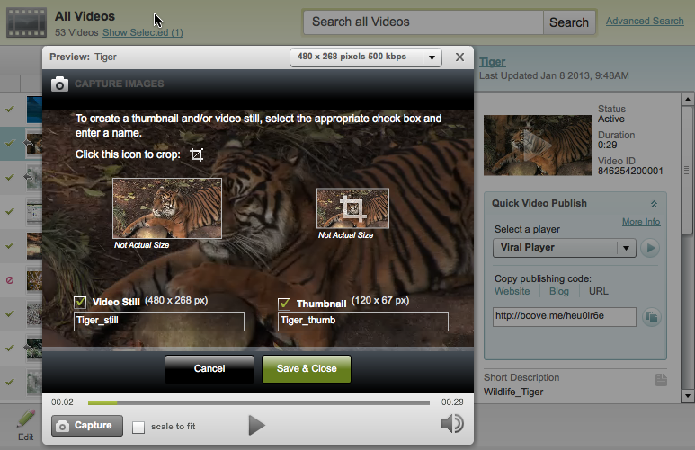
Video Properties: Image Capture
Notes:
30

Slide 31
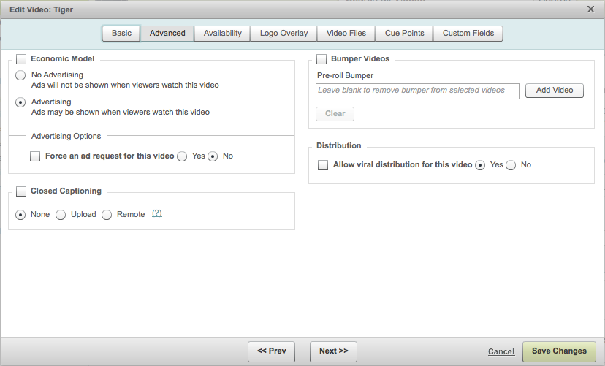
Video Properties: Advanced Settings
Notes:
31

Slide 32
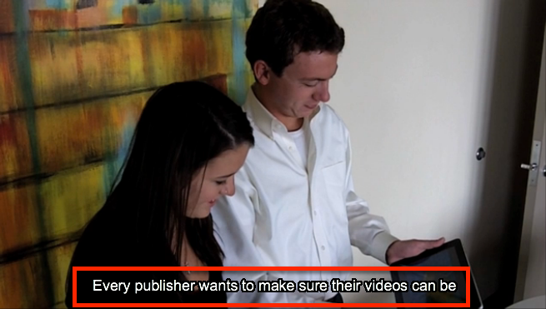
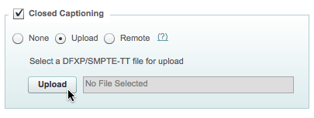
Video Properties: Advanced Settings
Create a captions file
Associate captions file with video using Media module
If video has a captions file associated with it, a “CC” button will appear on the player chrome
View captions in player
Notes:
32
The components involved in the Brightcove Platform

Slide 33
Video Properties: Advanced Settings
Note that video-level bumpers will not play unless you enable Video-Level Bumpers in the Video Player section of the Player Settings
Notes:
33

Slide 34
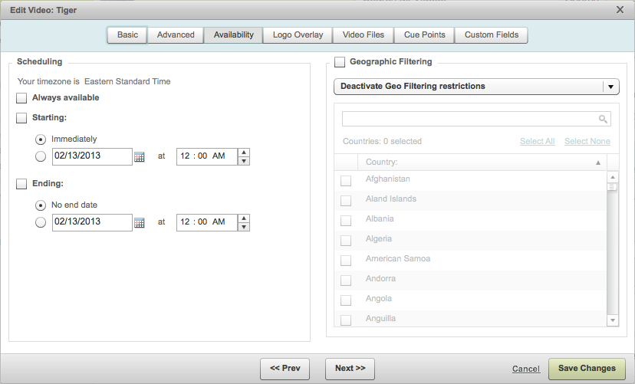
Video Properties: Availability
For Pro and Enterprise accounts
Schedule release windows
Geo-filter content to specific countries

Slide 35
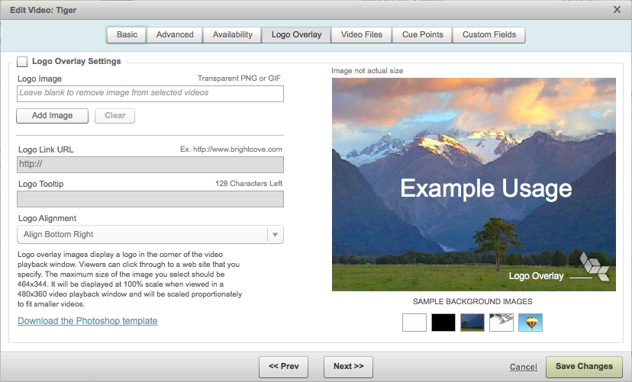
Video Properties: Logo Overlay
Notes:
35
35

Slide 36
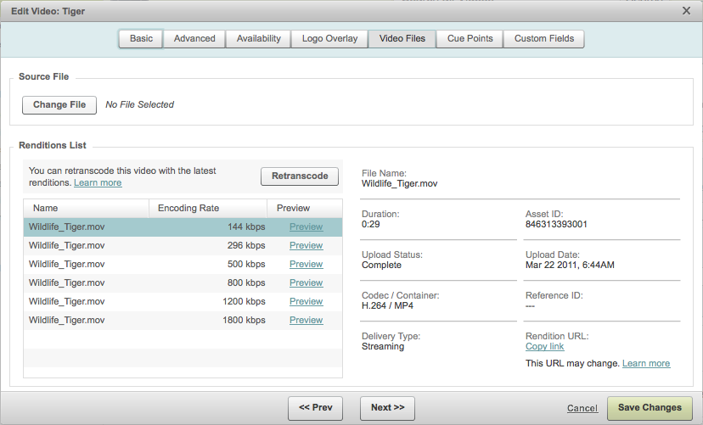
Video Properties: Previewing Renditions
Download link for the rendition
Notes:
36

Slide 37
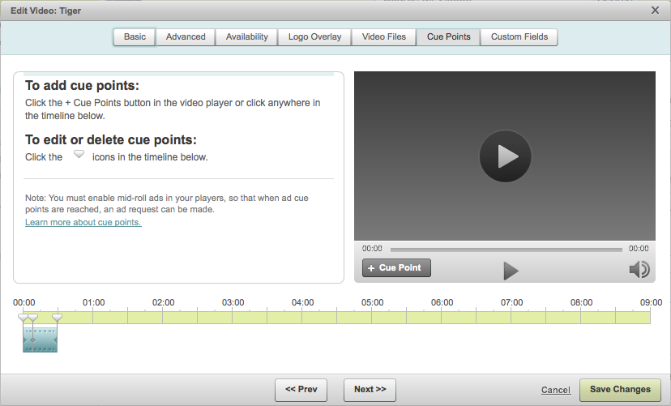
Video Properties: cue points
Notes:
37

Slide 38
Custom Fields
For CMS & Brightcove integration
Only Admin users can create Custom Fields
Self-serve addition of up to 10 custom video fields
Can add/remove values from a custom list
Can NOT edit display or internal names
Can NOT delete fields themselves, contact Customer Support
Custom fields are available for Pro and Enterprise Editions

Slide 39
Media Sharing
If you have multiple Video Cloud accounts
Lets you share videos with other publishers/accounts
Enables you to easily manage videos across multiple accounts
Use the Media module to share one video at a time to other accounts with which you have already established a sharing relationship.
Videos can be used independently in your affiliates' accounts
Can use media sharing to upload files once into your organization's multiple accounts
Media Sharing is available for Pro and Enterprise Editions

Slide 40
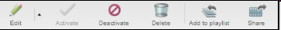
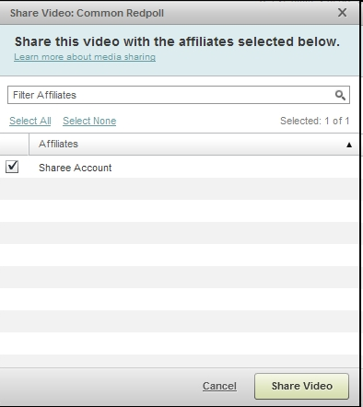
Media Sharing
To share a video:
Select a single video in the Media module
Click the Share button in the toolbar at the bottom of the Media module
Select the affiliates that you want to share the video to and click Share Video
Note: if the Share button is not visible, you only have a single account, or media sharing is not enabled

Slide 41
Creating and Customizing Players

Slide 42
Components of a Player
Playlists
Video Still
Name
Thumbnail
Short Description
Logo Overlay
Link Text
Viral Distribution
Advertising
Notes:
42

Slide 43
Spectrum of Visual Customization
Customizing Players with BEML
Developing with the Brightcove APIs
You are here
Methods
Publishing Module
BEML
Player APIs
Design Capabilities
Out-of-the-Box Templates
Styling
Layout
Size
CSS
Custom controls
Comments/Ratings
Non-Standard UI
Custom SWFs
Basic Design
HTML / XML
ActionScript/JavaScript
Skills
Pro and Enterprise Editions Only

Slide 44
Player Creation Process
Create* or Choose a Template
Create a Player
Configure Settings
Customize Style
Preview Player
Add Playlist(s)
**
*via BEML (Professional and Enterprise Editions)
**Only if using a multiple video player
Notes:
44
44
How abut we have a box that shows where BEML gets added in this…

Slide 45
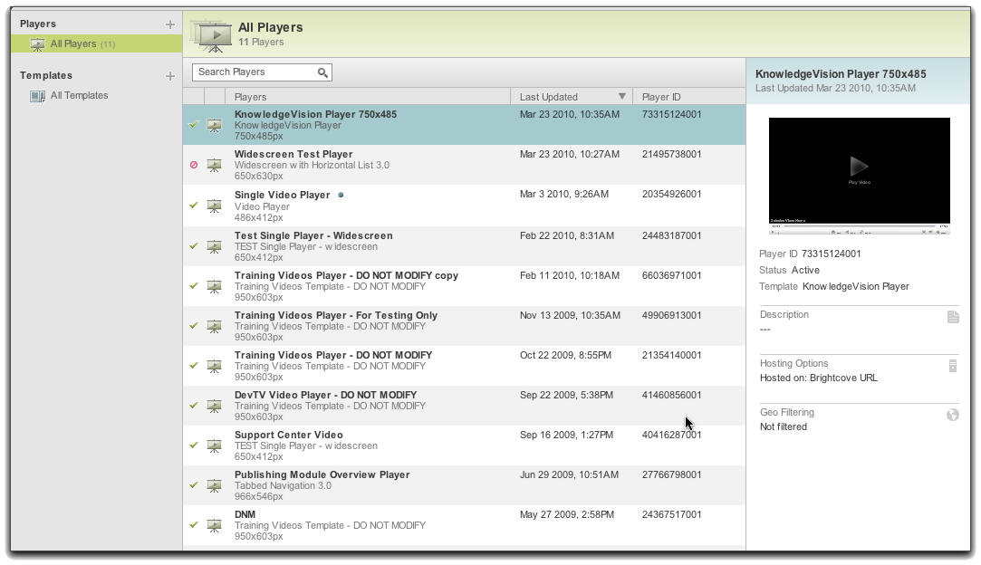
The Publishing Module
Notes:
45

Slide 46
VIDEO CLOUD’s Out of the Box Templates
Single video templates
Accessible Video Player
Video Player
Chromeless Video Player
Single Video Player with Logo
Mobile Optimized Video Player
Single playlist templates
Widescreen with Horizontal List
Widescreen with Vertical Video List
Widescreen with Video Text List
Video Player with Horizontal List 3.0
Mobile Optimized Player with Horizontal Playlist
Multiple playlist templates
Tabbed Navigation 3.0
Chromeless Video Player with Tabbed Playlists
Compact Tabbed Navigation 3.0
Widescreen with Dropdown Navigation
Video Player with Dropdown Navigation
Thumbnail Navigation Player
Notes:
46

Slide 47
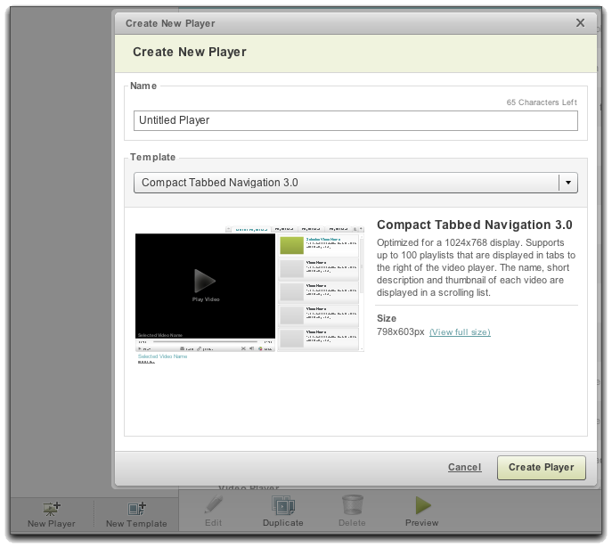
Creating a Player
If you will need to resize your player, look for words like “resizable” or “scalable” in the description

Slide 48
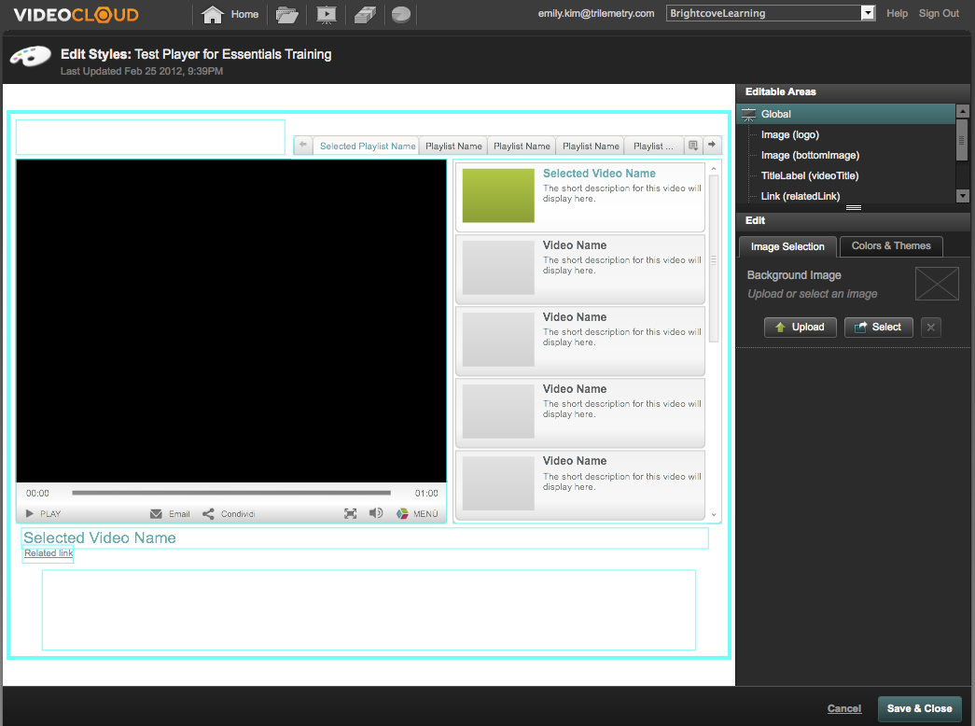
Customizable Styling
Each component exposes styling properties
Color
Gradient
Image
Notes:
48

Slide 49
Setting Player Properties

Slide 50
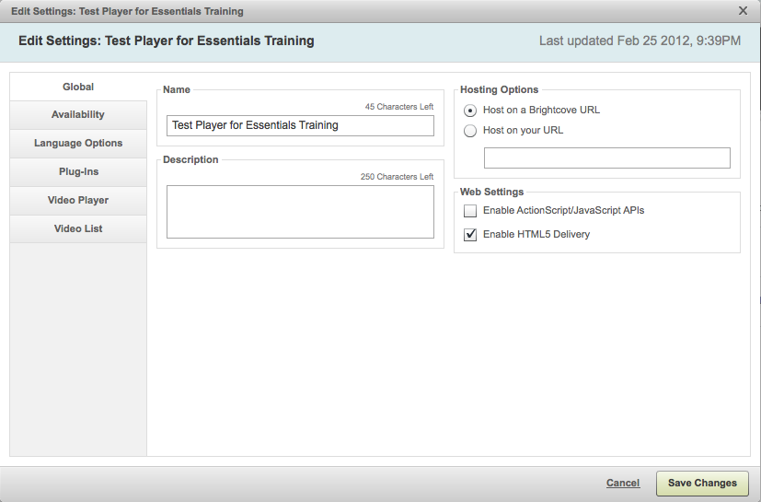
VIDEO CLOUD Player Settings: Global
Notes:
50

Slide 51
Global Settings
Global
Hosting Options
Host on your URL:
All traffic is directed back to your website
To see the player embedded in your page with page advertising, context, etc
Search results for the player will direct to your site

Slide 52
Global Settings
Global
Web Settings
Enable ActionScript/JavaScript APIs:
This gives you/your developer programmatic access to the underlying player object and data transfer objects
You must explicitly enable this or all API calls and plug-ins will FAIL silently
Notes:
New Flash AS3 call allows to enable this

Slide 53
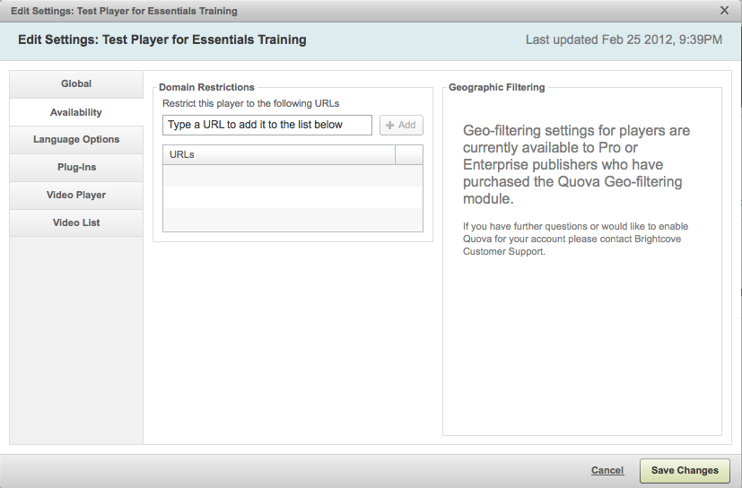
VIDEO CLOUD Player Settings: Availability
Notes:
53

Slide 54
Availability Settings
Availability
Domain Restriction
Restrict to your web domain: Enter a complete URL to restrict your player's availability to this particular domain – useful for paid or private content

Slide 55
Availability Settings
Availability
Geo-Filtering Options
(applies to commercial or government content that is legally restricted from being played in certain countries)
Turn off Geo Filtering: Everyone is allowed to view the player
Block the player from specific countries
Restrict the player to specific countries

Slide 56
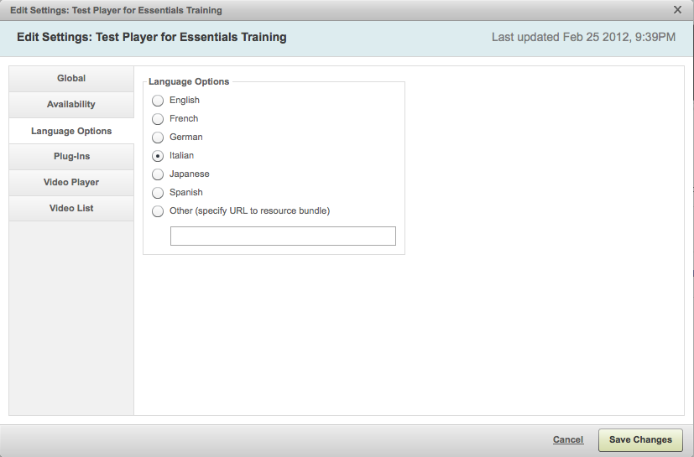
Language Options
For details of adding additional languages, see
http://support.brightcove.com/en/docs/localizing-players

Slide 57
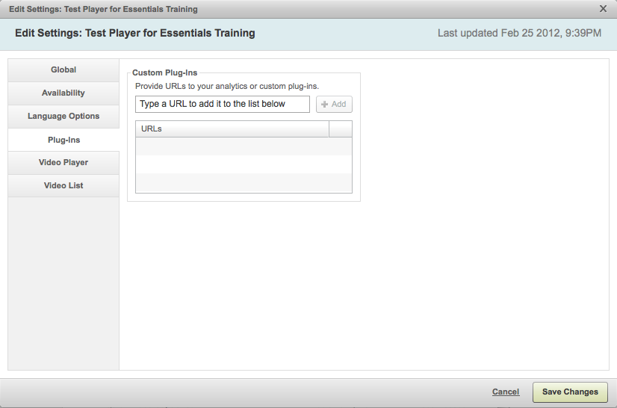
Plug-Ins
Remember to enable ActionScript/JavaScript APIs in Global Settings, or plug-ins will not work!

Slide 58
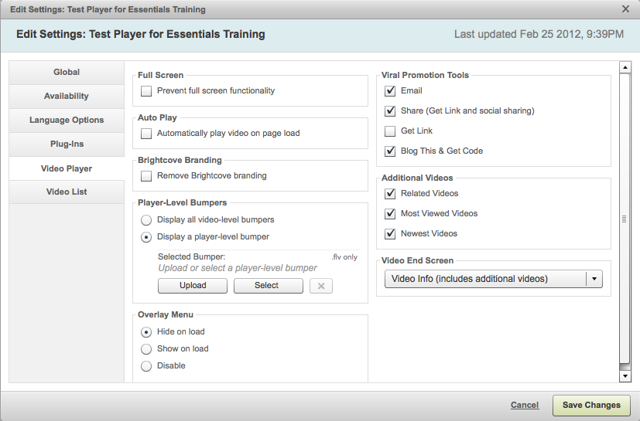
Video Player Settings

Slide 59
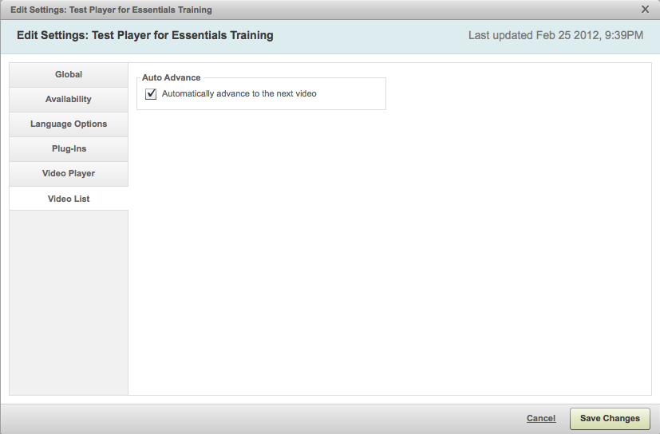
Video List Settings
Note: The Video List menu tab only appears if the player supports a playlist

Slide 60
Creating Playlists and Publishing

Slide 61
Playlists
MANUAL PLAYLIST
The list of videos is manually created
SMART PLAYLIST
The list of videos is constructed automatically, based on VIDEO TAGS
Videos

Slide 62
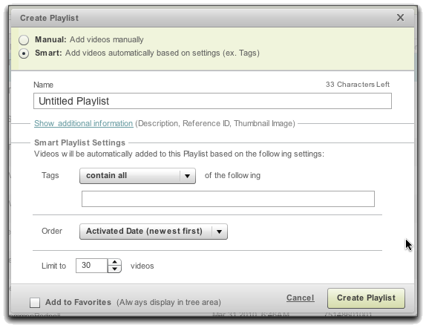
Smart Playlist – Tag Settings and Ordering Options
Tags
Contains All
Contains One or More
Order
Newest to Oldest
Oldest to Newest
Alphabetical
Total Plays*
Trailing Week Plays* * Compiled daily by our reporting feature and takes 24-48 hours to take effect with new content

Slide 63
Tag Taxonomy Example
Lancer Sports Company
Large, expansive website
Video content: high school, college, and professional sports
Video players: high school, college, and professional sports
Taxonomy of Tags
Audience Tags: High School, College, Professional
Month of Game Tags: January, February, March
Type of Sport Tags: Basketball, Hockey, Football
Location of the Game Tags: Boston, New York, Dallas
Region Tags: Northeast, Northwest, West, Southeast
SMART Playlists
“College” “Basketball” in “September” in the “Northeast”
Most recent “Professional” “Hockey” games in each “Region”
The “High School” “Basketball” games in the “Northeast” in the summer months (“June”,” “July”, “August”)
Notes:
63
They have about 6 tags to a video, that allows them to separate and create playlists based on these tags…Basketball, this month, last months, the one before…

Slide 64
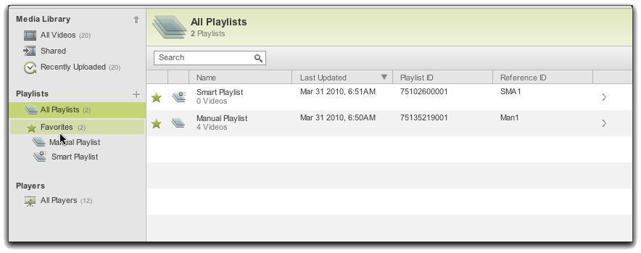
Favorites
Favorites is a way to:
Organize your playlists
Access the most commonly used
Easily drag videos into playlists

Slide 65
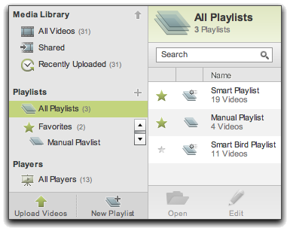
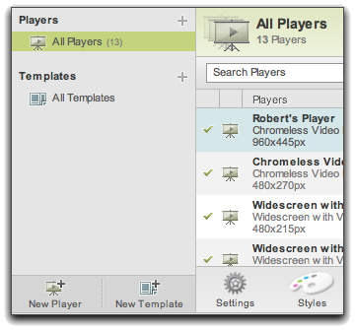
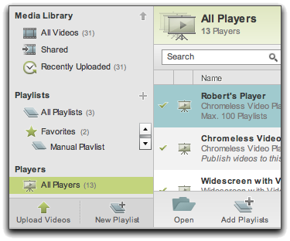
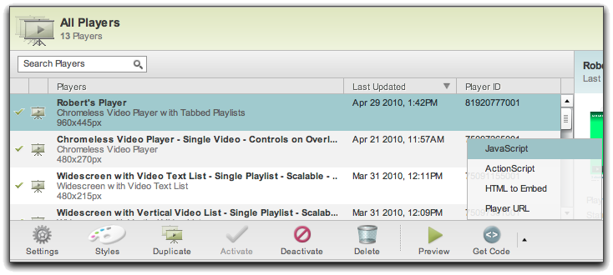
Publishing Summary – Playlists
Create a video player that supports multiple videos (Publishing Module)
Upload the videos (Media Module)
Create a playlist (Media Module)
Add the playlist(s) to the player (Media Module)
Copy the code (Publishing Module)
Paste the code in a web page (HTML editor)
Notes:
65
The components involved in the Brightcove Platform

Slide 66
Analytics

Slide 67
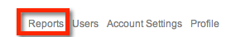
Reports vs. Analytics
Reports
Data on player loads, video loads, bandwidth consumption
Analytics Module
Data on video performance: what’s most watched, for how long, on what type of device, etc.

Slide 68

The Analytics Module
New Analytics module is in beta
Available reports
Account Overview
Performance
Engagement
More on the way…
View data in close to real-time
All report data can be downloaded as .csv files
Analytics API so you can create your own custom reports

Slide 69
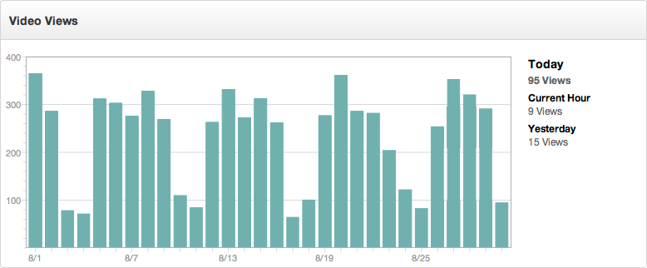
Analytics Module – account overview
Notes:
69

Slide 70
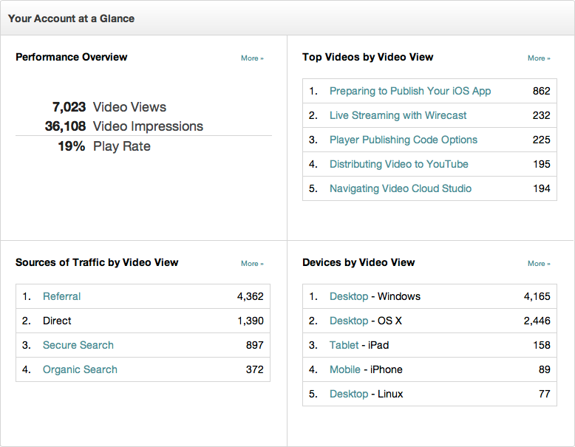
Analytics Module – account overview
Notes:
70

Slide 71



Analytics Module - performance
Performance by Video, Player or Source of Traffic, Device, Device Type and Device OS
Notes:
71

Slide 72

Analytics Module - performance
Selecting a video shows performance for that video
Notes:
72

Slide 73

Analytics Module - Engagement
Overall account engagement
View engagement by Video or Player
Notes:
73

Slide 74

Analytics Module - engagement
Selecting a video shows engagement for that video
Notes:
74

Slide 75
Account Management

Slide 76

Account usage reports
Reporting
Brightcove offers account usage reporting on:
Summary of Videos and Players
Total media loads (with subtotals for player loads and video plays)
Total megabytes downloaded (with subtotals for video and non-video bandwidth)
Video Plays
The number of times your videos have been viewed
Important for billing purposes (video plays + player loads)
Video Bandwidth
How many megabytes have been downloaded/streamed within a period of time
Pure video usage
Notes:
76

Slide 77

Users/Roles
There are two types of roles
Administrator
Adds/removes users and sets access rights
Except for own or Primary
Access and able to modify account settings
Standard
Assigned access to modules by Administrator
Notes:
Add and Remove Users on the account level
Basic accounts: limited to 1 user
Professional accounts: 10 users
Enterprise accounts: 50 users across 5 accounts
10 users per account by default, modified via CS
Purchase additional user accounts
cap/limit placed on additional user accounts for Basic

Slide 78


VIDEO CLOUD Roles & Workflow
You can set access for users based on workflow needs
Content
Players
Advertisements
Playlists
Players
Media Module
Publishing Module
Advertising Module
Producer
Editor
Designer
Advertising Operations
Developer
Analytics Module
Performance Metrics

Slide 79

Account Settings: Publishing Settings
For reporting purposes, set up a player just for viral distribution
Specify the domain for viral distribution links
Specify a logo overlay or burn-in for all videos in your account (set/override overlay in video settings)
Streaming accounts must enable this for mobile delivery
Enable HTML5 Players for iPads and iPhones
Enable HTML5 Advertising in players
Enable bandwidth detection for players

Slide 80

Account Settings: Analytics
Disable Analytics tracking if you don’t want it
Specify your local time zone for Analytics tracking and reporting
Collect information about the quality of Video Cloud video delivery

Slide 81

Transcode settings
Multi-Bitrate Streaming: Encoding Settings
Note: These settings can be modified in Pro and Enterprise Editions; changes can be requested from Brightcove Support for Express Editions
Primary
Rendition (created first)

Slide 82

Multi-Bitrate Streaming
Proprietary algorithm that adapts the quality of a video based on the player window and bandwidth
Returns the best available rendition
Screen height of the player
Viewer’s detected bandwidth
Not for FLV Files
Rendition changes dynamically for streaming delivery
Best version set at start of playback for progressive download
Notes:
82
If you select multiple renditions, Brightcove automatically takes your video file and transcodes it into four different FLV or H.264 files, each with different resolution and bit rate. Note that this option is not available if all of the video files you're uploading are already in FLV format, and any FLV files will not be transcoded into multiple renditions. If you are uploading an H.264 file, you have the option of retaining the original file as an additional rendition. For more information about dynamic delivery, see

Slide 83

Custom Fields

Slide 84


Custom Fields
Account Settings
Video Settings

Slide 85
Additional Resources
Notes:
85

Slide 86
Online training and Quick start guide
Video Cloud Essentials Training On-Demand
Recorded version of Video Cloud Essentials training
http://bit.ly/W3U2JU
Video Cloud Analytics Essentials Training On-Demand
Recorded version of Video Cloud Analytics Essentials training
http://bit.ly/14e6VFG
Quick Start to Video Cloud
Set of hands on steps you can work through on your own to discover some of the features of Video Cloud
http://bit.ly/UZkLZp
Notes:
86
86

Slide 87

Additional training courses
Brightcove.com > Services > Training
Notes:
87
87

Slide 88

Support Documentation
Notes:
88
88

Slide 89

Training Videos
Notes:
89

Slide 90

Online Support
Notes:
90
90

Slide 91

Developer resources
http://docs.brightcove.com/en/index.html
Notes:
91

Slide 92
Open-Source SDKs
Media API SDKs
Video Cloud App SDK for iOS
Video Cloud App SDK for Android
Player API SDK
Advertising SDKs
For more information and downloads:
http://support.brightcove.com/en/docs/brightcove-sdks
Notes:
92

Slide 93
Thank you

